Slide 1
Graph Theory
IOI Training Camp 1 – 2017/2018
Bronson Rudner

Slide 2
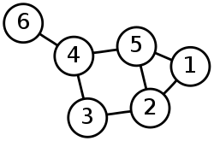
What is a graph?
Nodes
Edges
An edge joins exactly 2 nodes
E.g. Cities (Nodes) connected by roads (Edges).

Slide 3
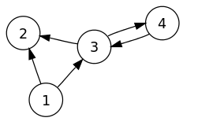
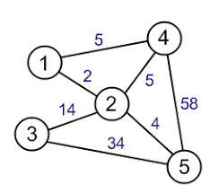
Typical Variations
Edges may be directed.
Edges may be weighted.

Slide 4
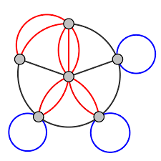
More Variations
A graph could have loops.
Multiple edges between two nodes.
Typically problems involve simple graphs, which have no loops and at most one edge between two nodes.

Slide 5
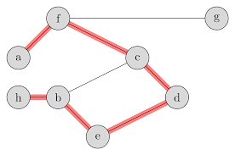
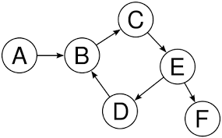
Definitions
Path
Cycle
B-C-E-D

Slide 6
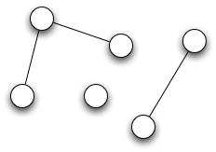
Definitions
A connected graph
A disconnected graph
3 Components

Slide 7
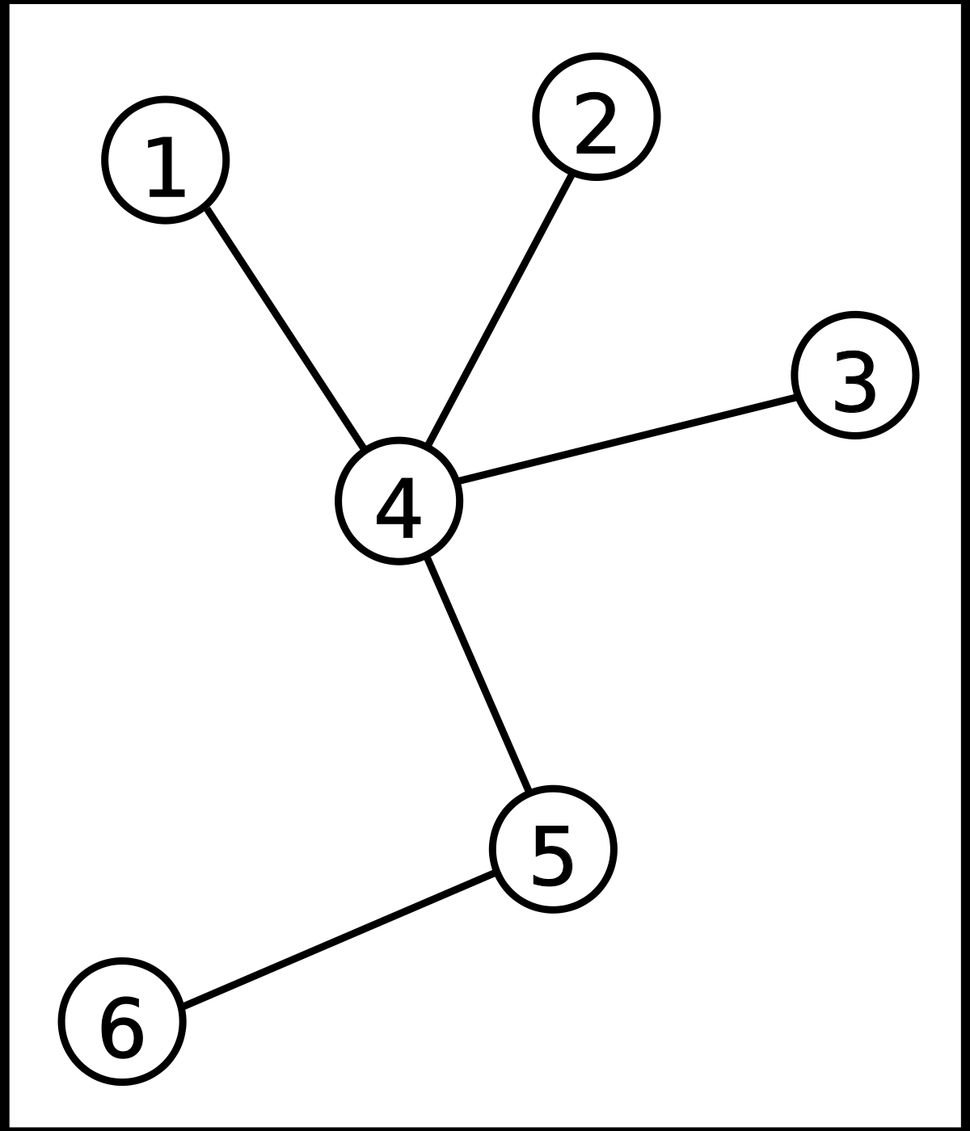
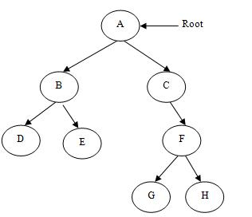
Definitions
Tree
Forest – a collection of trees

Slide 8
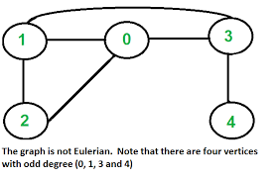
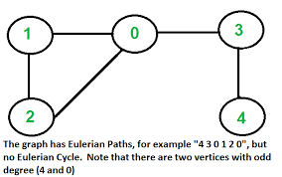
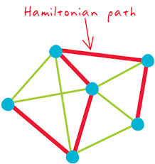
Definitions
Eulerian path
Hamiltonian path

Slide 9
Representing a graph
1
3
2
A list of edges
5
3
{ (1,2,3) , (2,3,5) }

Slide 10
Representing a graph
1
3
2
An adjacency matrix
5
3
 | 1 | 2 | 3
1 | - | 3 | inf
2 | 3 | - | 5
3 | inf | 5 | -

Slide 11
Representing a graph
1
3
1: (2, 3)
2: (1, 3) , (3, 5)
3: (2, 5)
2
5
3
An adjacency list

Slide 12
Depth first search
Start from some node.
Visit all nodes in a connected component.
Walk as far as possible along a path in the graph before backtracking.

Slide 13
Breadth first search
Start from some node.
Visit all nodes in a component.
Visit nodes closest to the starting node first.

Slide 14
Dijkstra's Algorithm
Used in a weighted graph.
Determine shortest distance from one node to each of the others.
Breadth first search using a priority queue.

Slide 15
Dijkstra's Algorithm

Slide 16
Floyd’s Algorithm
Used in a weighted graph.
Determine shortest distance from one node to each of the others.
Makes use of an adjacency matrix.

Slide 17
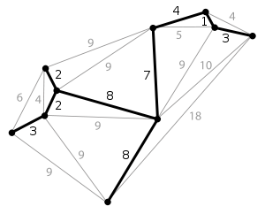
Minimum Spanning Tree
Subset of edges of a weighted, undirected graph.
Tree, containing all nodes, with smallest sum of weights of edges.
Can use Prim’s or Kruskal’s Algorithm to determine.

Slide 18
Prim’s Algorithm
Start with a set of 1 node.
Keep adding the node with smallest distance to some node currently in your set.

Slide 19
Kruskal’s Algorithm
Start with each node its own component (so no edges).
Loop through edges, from smallest to largest weight.
If an edge joins two different components, add it to the graph.
Makes use of the union-find data structure.

Slide 20
Kruskal’s Algorithm

Slide 21
Union-find Data Structure

